Slide 1
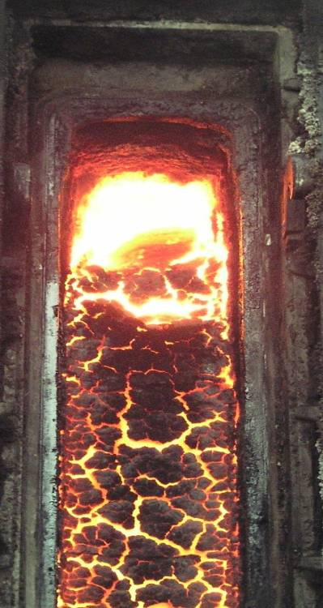
2021 MESH UPDATE
2020 – presented significant challenges, with no in-person meetings. Activity from a MESH perspective, like general membership meetings – ON HOLD.
~Late 3Q2021 – Planning to conduct an in-person, 2-day MESH meeting. Meeting will be conducted in the Pittsburgh area, with a comprehensive 4-5 hour “boots on the ground” tour of the USS Clairton facilities:
Tour options will be provided – either coal and coke operations or chemicals and utilities operations.
MESH Meeting - Program Content/Format:
Day 1: AM session – Member Companies only – Safety and Environmental
Day 1: PM Session – 4-5 hour tour of USS Clairton Works (training must be completed in advance, no training = no tour) – suppliers can join tour. Group dinner to follow tour.
Day 2: All day session – industry technical presentations

